Slide 2
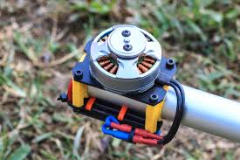
First Course of Special Machine
Department of Electrical Power and Machine Engineering
By Qasim Al Azze 2018

Slide 3
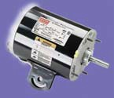
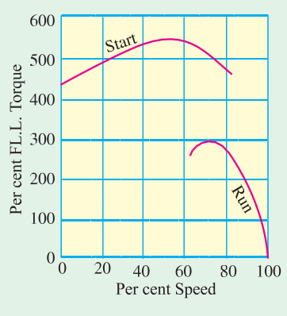
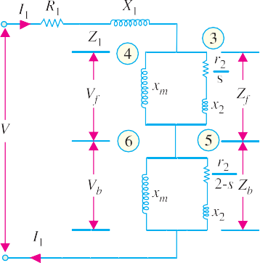
Single-phase Motors
1373
75 per cent of full speed, the centrifugal switch S opens and cuts out both the starting winding and the capacitor from the supply, thus leaving only the running winding across the lines. As shown in Fig.
Capacitor start/capacitor-run motor.
36.12, current I_{m} drawn by the main winding lags the supply voltage V by a large angle whereas I_{s} leads V by a certain angle. The two currents are out of phase with each other by about 80º (for a 200-W 50-Hz motor) as compared to nearly 30º for a split-phase motor. Their resultant current I is small and is almost in phase with V as shown in Fig. 36.12.
Since the torque developed by a split-phase motor is proportional to the sine of the angle between I_{s} and I_{m} , it is
obvious that the
increase in the angle (from 30º to 80º) alone increases the starting
torque to nearly twice the value developed by a standard split- phase induction motor. Other improvements in motor design have made it possible to increase the starting torque to a value as high as 350 to 450 per cent.
Typical performance curve of such a motor is shown in Fig. 36.13.
Fig. 36.13
36.5. Equivalent Circuit of a Single- phase Induction Motor–Without Core Loss
A single-phase motor may be looked upon as consisting of two motors, having a common stator winding, but with their respective rotors revolving in opposite directions. The equivalent circuit of such a motor based on double-field revolving theory is shown in Fig. 36.14. Here, the single- phase motor has been imagined to be made-up of (i) one stator winding and (ii) two imaginary rotors. The stator impedance is Z = R₁ + j X₁. The impedance of each rotor is (r₂ + jx₂) where r₂ and x₂ represent half the actual rotor values in stator terms (i.e. x₂ stands for half the standstill reactance of the rotor, as referred to stator). Since iron loss has been neglected, the exciting branch is shown consisting of exciting reactance only. Each rotor has been assigned half the magnetising reactance* (i.e x_{m} represents half the actual reactance). The
Fig. 36.14
impedance of ‘forward running’ rotor is
⎛ r ⎞
j x ⎜
2
j x₂ ⎟
Z_{f} =
r
m
⎝ s ⎠
² + j (x_{m} + x₂)
s
and it runs with a slip of s. The impedance of ‘backward’ running rotor is
* In fact, full values are shown by capital letters and half values by small letters.

Slide 4
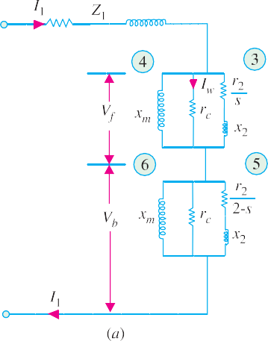
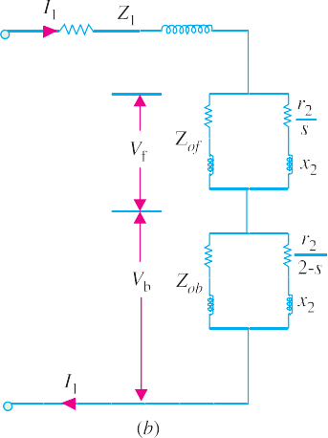
1374
Electrical Technology
j x ⎛
r₂
j x ⎞
^{m ⎜} 2 − s
2 ⎟
_{Z =} ⎝ ⎠
b
r₂
2 − s
j (x + x )
m 2
and it runs with a slip of (2 − s). Under standstill conditions, V_{f} = V_{b} , but under running conditions V_{f}
is almost 90 to 95% of the applied voltage.
The forward torque in synchronous watts is T = I ² r / s. Similarly, backward torque is
T = I ² r / (2 − s)
f 3 2
b 5 2
The total torque is
T = T_{f} − T_{b}.
36.6. Equivalent Circuit–With Core Loss
The core loss can be represented by an equivalent resistance which may be connected either in parallel or in series with the magnetising reactance as shown in Fig. 36.15.
Since under running conditions V_{f} is very high (and V_{b} is correspondingly, low) most of the iron loss takes place in the ‘forward motor’ consisting of the common stator and forward-running rotor. Core-loss current I_{w} = core loss / V_{f}. Hence, half value of core-loss equivalent resistance is r_{c} = V_{f} / I_{w}. As shown in Fig. 36.15 (a), r_{c} has been connected in parallel with x_{m} in each rotor.
Fig. 36.15
Example 36.1. Discuss the revolving field theory of single-phase induction motors. Find the mechanical power output at a slip of 0.05 of the 185-W, 4-pole, 110-V, 60-Hz single-phase induction motor, whose constants are given below:
Resistance of the stator main winding R₁ = 1.86 ohm
Reactance of the stator main winding X₁ = 2.56 ohm Magnetizing reactance of the stator main winding X_{m} = 53.5 ohm
Rotor resistance at standstill R₂ = 3.56 ohm
Rotor reactance at standstill X₂ = 2.56 ohm
(Elect. Machines, Nagpur Univ. 1991)
Solution. Here, X_{m} = 53.5 Ω, hence x_{m} = 53.5/2 = 26.7 Ω
Similarly, r₂ = R₂ / 2 = 3.56 / 2 = 1.78 Ω and x₂ = X ₂ / 2 = 2.56 / 2 = 1.28 Ω

Slide 5
Single-phase Motors
1375
j x
⎛ r_{2 + j x} ⎞
^{r2} . x + j ⎡(r / s)² + x
_{x} ⎤
∴
Z =
m ⎝ _{s}
2 ⎠
= x
m
s
m ⎣ 2 2 0 ⎦
where x = (x + x )
f
r₂
(r / s)² + x²
0 m 2
_{s} + j (x₂ + x_{m})
2 0
∴
Z_{f} = 26.7
(1.78 / 0.05) × 26.7 + j [(1.78 / 0.05)² + 1.28 × 27.98]
= 12.4 + j 17.15 = 21.15 ∠54.2º
(1.78 / 0.05)² + (27.98)²
r
⎡⎛
r
⎞2
⎤
r₂
⎛ ⎞
+ x₀ x₂ ⎥
j x ⎛ + j x ⎞
⎜
⎜ ² ⎟ ^{x}m ^{+ j ⎢}⎜ ² ⎟
m
₂ ⎟
⎝ 2 − s ⎠
⎣⎢⎝ 2 − s ⎠
⎦⎥
Similarly, Z =
⎝ 2 − s ⎠
= x
⎞2
b
r₂
m
⎛ r
_{2 − s} + j (x₂ + x_{m})
⎜ 2 ⎟
x²
⎝ 2 − s ⎠
0
= 26.7
(1.78 / 1.95) × 26.7 + j [(1.78 / 1.95)² + 1.28 × 27.98]
(1.78 / 1.95)² + (27.98)²
= 0.84 + j 1.26 = 1.51 ∠56.3º
Z₁ = R₁ + j X₁ = 1.86 + j 2.56 = 3.16 ∠ 54º
Total circuit impedance is
Z₀₁ = Z₁ + Z_{f} + Z_{b} = (1.86 + j 2.56) + (12.4 + j 17.15) + (0.84 + j 1.26)
= 15.1 + j 20.97 = 25.85∠54.3º
Motor current I₁ = 110/25.85 = 4.27 A
V_{f} = I₁ Z_{f} = 4.27 × 21.15 = 90.4 V; V_{b} = I₁ Z_{b} = 4.27 × 1.51 = 6.44 V
⎛ r ⎞²
⎛ r
⎞2
Z₃ =
⎜ 2 ⎟
x
2
= 35.7 Ω, Z =
2
2
2
⎜ ⎟
+ x₂ = 1.57 Ω
⎝ ^{s} ⎠
5
⎝
2 − s ⎠
I₃ = V_{f} / Z₃ = 90.4/35.7 = 2.53 A, I₅ = V_{b} /Z₅ = 6.44/1.57 = 4.1 A
T = I ² R / s = 228 synch. watts, T = I ² r /(2 − s) = 15.3 synch. watts.
f 3 2 5 5 2
T = T_{f} − T_{b} = 228 − 15.3 = 212.7 synch. watts Output = synch. watt × (1 − s) = 212.7 × 0.95 = 202 W
Since friction and windage losses are not given, this also represents the net output.
Example 36.2. Find the mechanical power output of 185-W, 4 pole, 110-V, 50-Hz single-phase induction motor, whose constants are given below at a slip of 0.05.
R₁ = 1.86 Ω X₁= 2.56 Ω X_{φ} = 53.5 Ω R₂ = 3.56 Ω X₂ = 2.56 Ω
Core loss = 3.5 W, Friction and windage loss = 13.5 W.
(Electrical Machines-III, Indore Univ. 1987)
Solution. It would be seen that major part of this problem has already been solved in Example
36.1. Let us, now, assume that V_{f} = 82.5% of 110 V = 90.7 V. Then the core-loss current I_{c} = 35/90.7
= 0.386 A ; r_{c} = 90.7/0.386 = 235 Ω.
Motor I
conductance of core-loss branch = 1/r_{c} = 1/235 = 0.00426 S susceptance of magnetising branch = − j / x_{m} = − j/26.7 = − j 0.0374 S
admittance of branch 3 =
(r₂ / s) − j x₂
_{(r / s)}2 _{+ x}2 = 0.028 − j 0.00101 S
2
2

